Slide 1
Sinusoidal Steady-State Analysis
Chapter 9

Slide 2
Week 7 - 9 Chapter 9 (Sinusoidal Steady-State Analysis)
The Sinusoidal Source
The Sinusoidal Response
The Phasor
Passive Circuit Elements in the Frequency Domain
KCL and KVL in the Frequency Domain
Series, Parallel, and Delta-Wye Simplifications
Source Transformations, Thevenin-Norton Equivalent Circuits
The Node-Voltage Method
The Mesh-Current Method
9.X Superposition
The Transformer
The Ideal Transformer
Phasor Diagrams

Slide 3
Week 7 - 9 Chapter 9 (Sinusoidal Steady-State Analysis)
The Sinusoidal Source
The Sinusoidal Response
The Phasor
Passive Circuit Elements in the Frequency Domain
KCL and KVL in the Frequency Domain
Series, Parallel, and Delta-Wye Simplifications
Source Transformations, Thevenin-Norton Equivalent Circuits
The Node-Voltage Method
The Mesh-Current Method
9.X Superposition
The Transformer
The Ideal Transformer
Phasor Diagrams

Slide 4
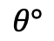
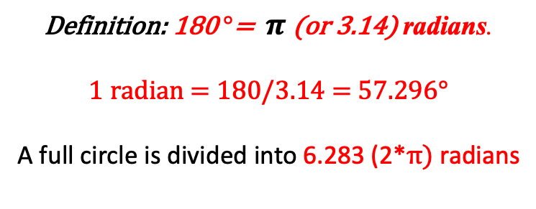
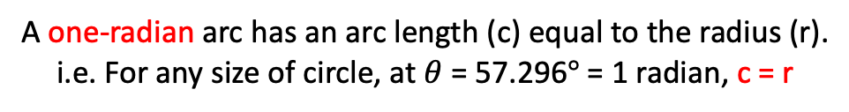
9.0 Degrees, Cycles & Radians
Definition: 180 $°$= $π$ (or 3.14) radians.
1 radian = 180/3.14 = 57.296$°$
A full circle is divided into 6.283 (2*$π)$ radians
r
c
$$θ°$$
A one-radian arc has an arc length (c) equal to the radius (r).
i.e. For any size of circle, at $θ$ = 57.296$°$ = 1 radian, c = r

Slide 5

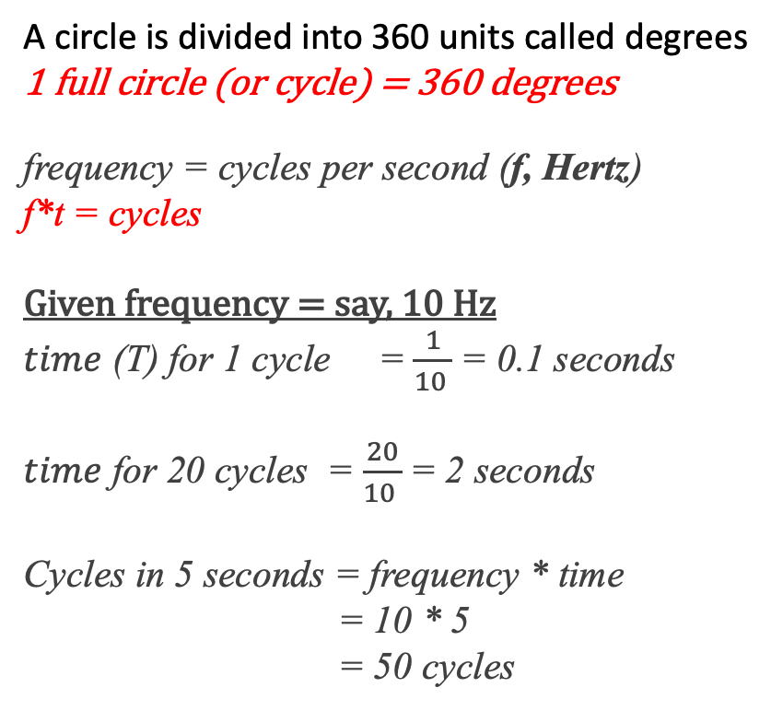
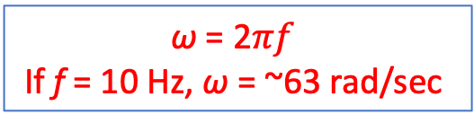
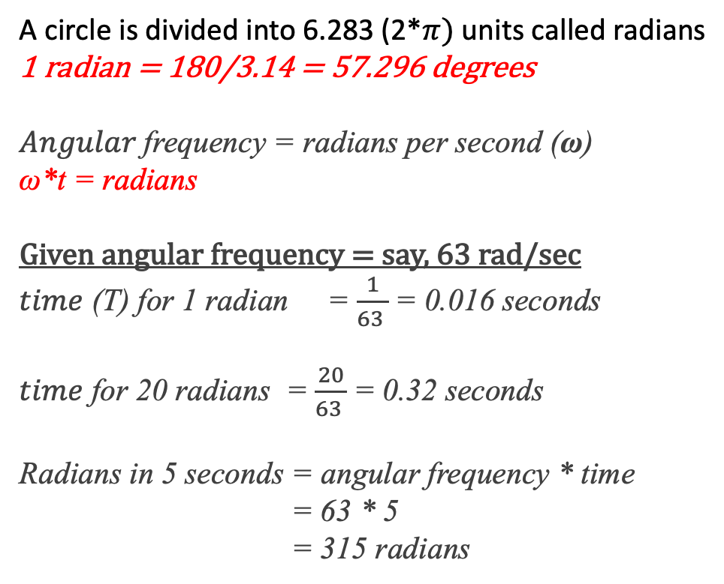
9.0 Degrees, Cycles & Radians
A circle is divided into 360 units called degrees
1 full circle (or cycle) = 360 degrees
frequency = cycles per second (f, Hertz)
f*t = cycles
Given frequency = say, 10 Hz
$time$ (T) for 1 cycle = $\frac{1}{10 }$= 0.1 seconds
$time$ for 20 cycles = $\frac{20}{10 }$= 2 seconds
Cycles in 5 seconds = frequency * time
= 10 * 5
= 50 cycles
A circle is divided into 6.283 (2*$π)$ units called radians
1 radian = 180/3.14 = 57.296 degrees
$Angular$frequency = radians per second (ω)
ω*t = radians
Given angular frequency = say, 63 rad/sec
$time$ (T) for 1 radian = $\frac{1}{63 }$= 0.016 seconds
$time$ for 20 radians = $\frac{20}{63 }$= 0.32 seconds
Radians in 5 seconds = angular frequency * time
= 63 * 5
= 315 radians
r
c
$$θ$$
ω = 2$πf$
If f = 10 Hz, ω = ~63 rad/sec

Slide 6
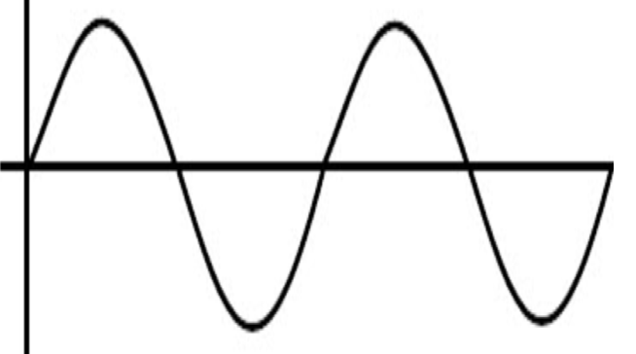
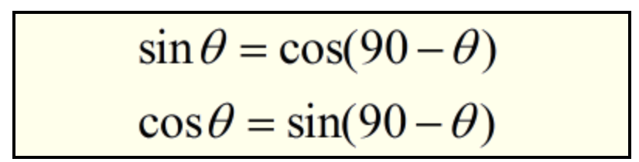
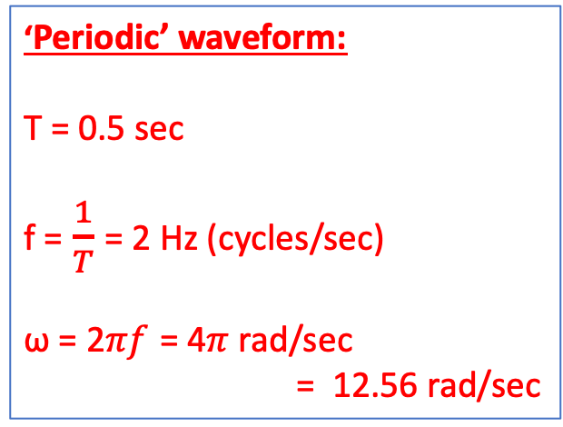
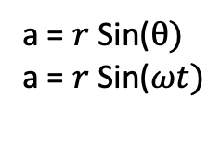
9.0 Degrees, Cycles & Radians & Periodic Waveforms
‘Periodic’ waveform:
T = 0.5 sec
f = $\frac{1}{T}$ = 2 Hz (cycles/sec)
ω = 2$πf$ = 4$π$ rad/sec
= 12.56 rad/sec
r
a
a
0.5 sec
1 sec
$$θ°$$
T
(period)
a = $r$ Sin($θ)$
a = $r$ Sin($ωt)$
Earlier time
Later time, future

Slide 7
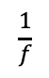
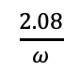
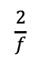
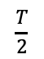
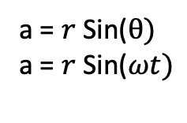
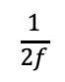
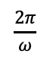
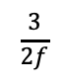
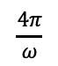
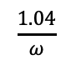
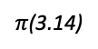
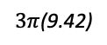
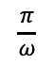
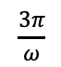
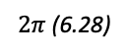
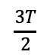
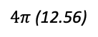
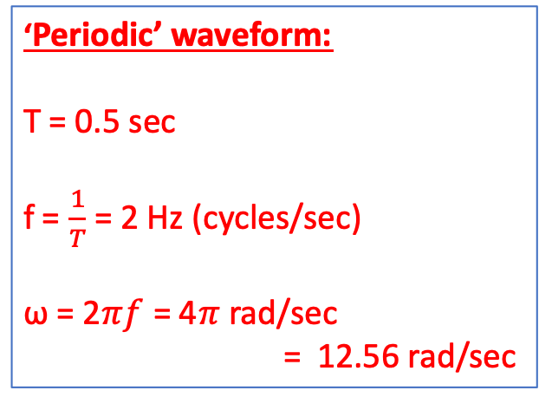
‘Periodic’ waveform:
T = 0.5 sec
f = $\frac{1}{T}$ = 2 Hz (cycles/sec)
ω = 2$πf$ = 4$π$ rad/sec
= 12.56 rad/sec
r
a
a
0.5 sec
1 sec
$$θ°$$
a = $r$ Sin($θ)$
a = $r$ Sin($ωt)$
0
180
360
540
720
°, degrees
Degrees
$$\frac{T}{2}$$
T
$$\frac{3T}{2}$$
2T
#, Periods
$$\frac{1}{2f}$$
$$\frac{1}{f}$$
$$\frac{3}{2f}$$
$$\frac{2}{f}$$
t, seconds
Radians
$π$(3.14)
$2π$ (6.28)
$3π$(9.42)
$4π$ (12.56)
rad, radians
$$\frac{1.04}{ω}$$
$$\frac{2.08}{ω}$$
$$\frac{π}{ω}$$
$$\frac{2π}{ω}$$
$$\frac{3π}{ω}$$
$$\frac{4π}{ω}$$
t, seconds

Slide 8
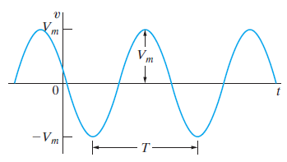
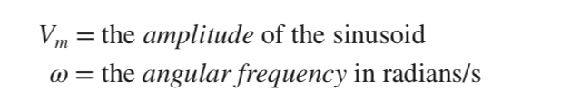
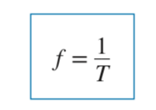


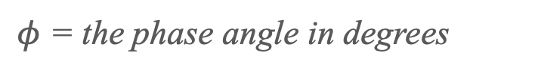
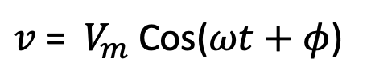
9.1 The Sinusoidal Source
$φ$ = the phase angle in degrees
$v$= ${ V}_{m}$ Cos($ωt+φ$)
${ V}_{rms}$= $\frac{{ V}_{m}}{\sqrt{2}}$

Slide 9
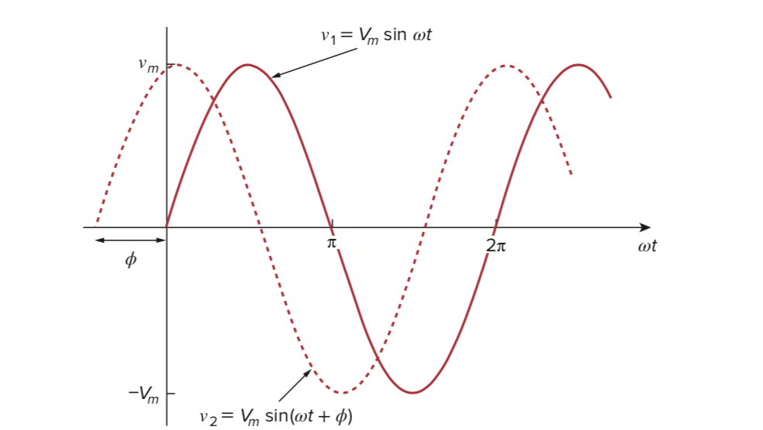
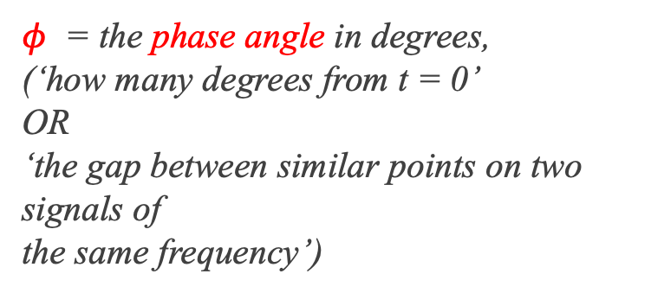
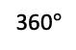
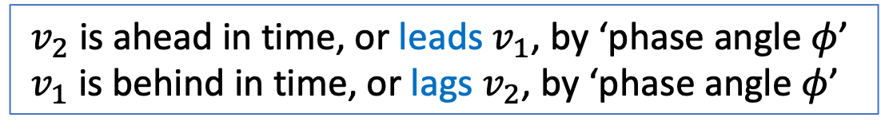
9.1 The Sinusoidal Source
$φ$ = the phase angle in degrees,
(‘how many degrees from t = 0’
OR
‘the gap between similar points on two signals of
the same frequency’)
360$°$
Earlier time
Later time, future
${ v}_{2}$ is ahead in time, or leads${ v}_{1}$, by ‘phase angle $φ$’
${ v}_{1}$ is behind in time, or lags${ v}_{2}$, by ‘phase angle $φ$’

Slide 10
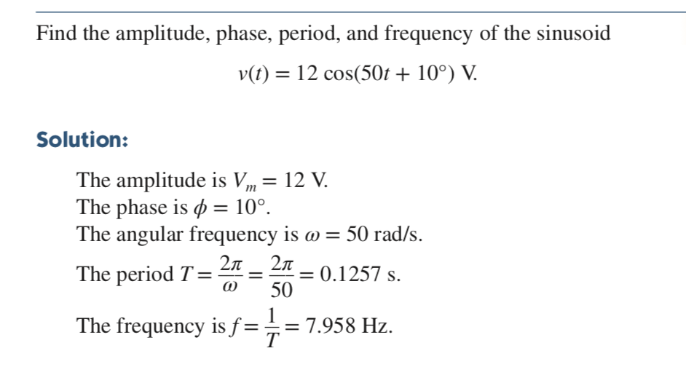

9.1 The Sinusoidal Source
Check: ω = 2$πf$ = 2$π∗7.958$ = 50 rad/sec

Slide 11
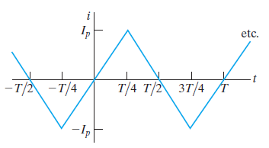
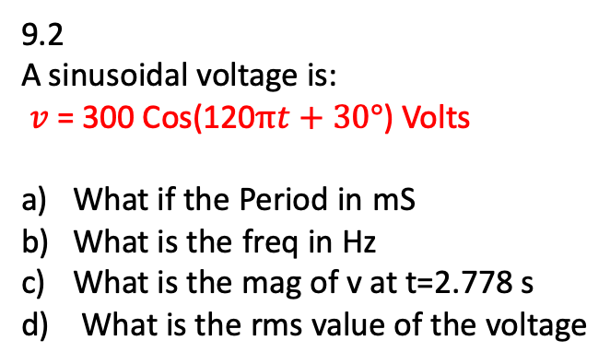
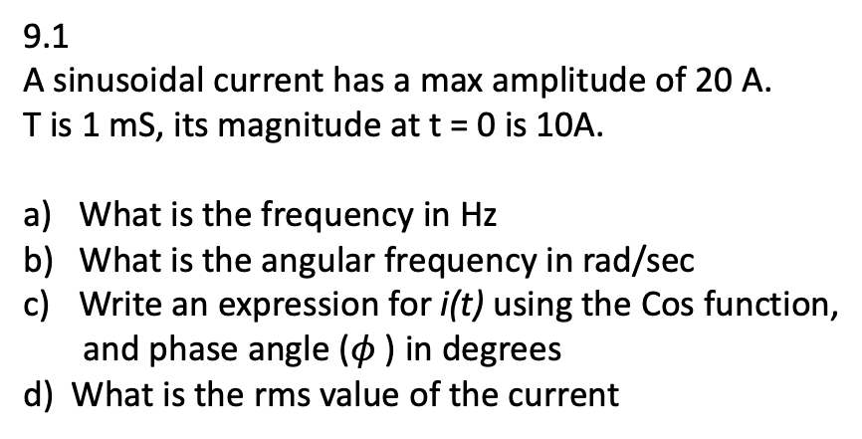
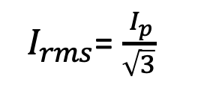
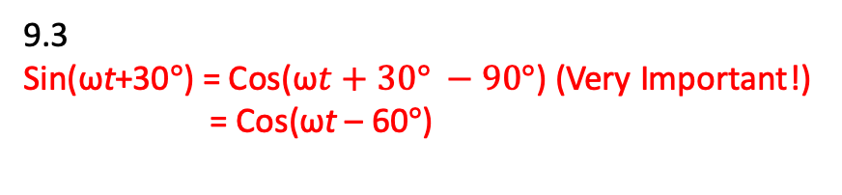
9.1 The Sinusoidal Source – Examples 9.1, 9.2, 9.3, 9.4
9.1
A sinusoidal current has a max amplitude of 20 A.
T is 1 mS, its magnitude at t = 0 is 10A.
What is the frequency in Hz
What is the angular frequency in rad/sec
Write an expression for i(t) using the Cos function,
and phase angle ($φ$ ) in degrees
d) What is the rms value of the current
9.2
A sinusoidal voltage is:
$v$= 300 Cos(120$πt+30°$) Volts
What if the Period in mS
What is the freq in Hz
What is the mag of v at t=2.778 s
d) What is the rms value of the voltage
9.3
Sin(ωt+30$°$) = Cos(ω$t+30° −90°$) (Very Important!)
= Cos(ωt – 60$°$)
9.4
${ I}_{rms}$= $\frac{{ I}_{p}}{\sqrt{3}}$

Slide 12
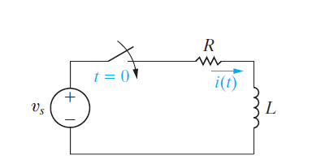
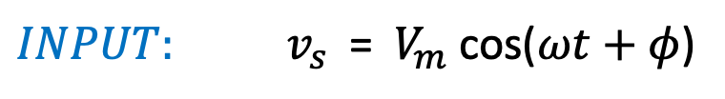
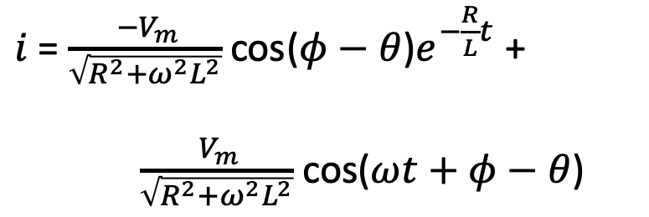
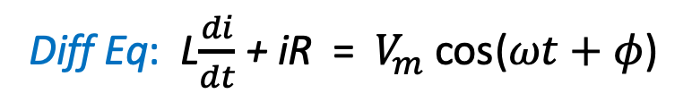
9.2 The Sinusoidal Response
Figure 9.5: An RL circuit excited by a sinusoidal voltage source.
${INPUT: v}_{s}$= ${ V}_{m}$ cos($ωt+φ$)
Diff Eq: L$\frac{di}{dt}$+ iR = ${ V}_{m}$ cos($ωt+φ$)
RESPONSE:
$i$= $\frac{{ −V}_{m}}{\sqrt{{R^{2}+ω}^{2}L^{2}}}$ cos($φ−θ$)$e^{−\frac{R}{L}t}$ +
$\frac{{ V}_{m}}{\sqrt{{R^{2}+ω}^{2}L^{2}}}$ cos($ωt+φ−θ$)

Slide 13
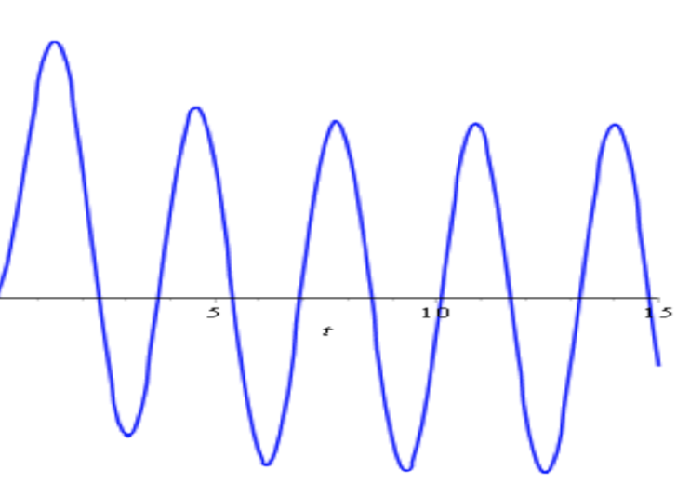
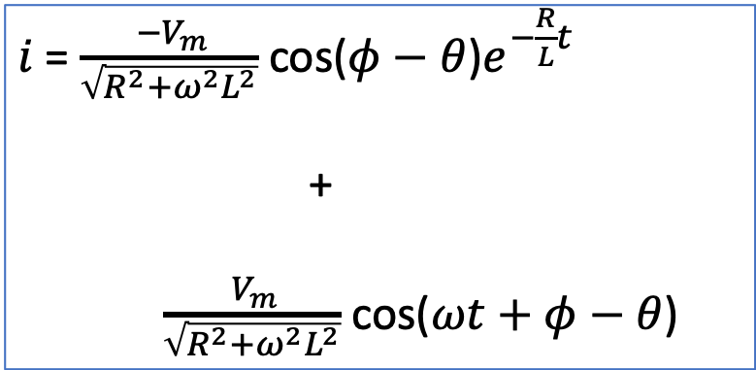
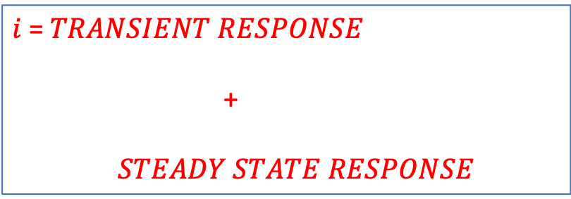
9.2 The Sinusoidal Response
$i$= $TRANSIENT RESPONSE$
+
$STEADY STATE RESPONSE$
$i$= $\frac{{ −V}_{m}}{\sqrt{{R^{2}+ω}^{2}L^{2}}}$ cos($φ−θ$)$e^{−\frac{R}{L}t}$
+
$\frac{{ V}_{m}}{\sqrt{{R^{2}+ω}^{2}L^{2}}}$ cos($ωt+φ−θ$)
Transient response
Steady-state response

Slide 14

9.3 The Phasor – Appendix B (Review of Complex Numbers)
A complex number is a number of the form a + b$i$
where a and b are real numbers,
and $i$ is an indeterminate satisfying $i$² = −1
For example, 2 + 3$i$ is a complex number.
In electrical engineering, we write this as
2 + 3j

Slide 15









9.3 The Phasor – Appendix B (Review of Complex Numbers)
$j^{2}$ = -1
z = r(cos$φ$ + j sin$φ$)

Slide 16





9.3 The Phasor – Appendix B (Review of Complex Numbers)

Slide 17




9.3 The Phasor – Appendix B (Review of Complex Numbers)

Slide 18




9.3 The Phasor – Examples (Review of Complex Numbers)
$n_{1}$ = 8 + j16
$n_{2}$ = 12 – j3
$n_{1}$ + $n_{2}$ = (8 + j16) + (12 – j3)
= 20 + j13
$n_{1}$ = 8 + j10 OR $n_{1}$ = 12.81 51.34°
$n_{2}$ = 5 – j4 OR $n_{2}$ = 6.40 -38.66°
$n_{1}$* $n_{2}$ = (12.81 * 6.40) (51.34 + (-38.66))
= 82 -12.68°
= 80 + j18
$n_{1}$ = 8 + j16
$\frac{n_{1}}{n_{2}}$ = $\frac{\text{12.81 51.34°}}{\text{6.40 −38.66°}}$
= 2.00 90$\text{°}$

Slide 19

9.3 The Phasor – Casio fx-115ES Plus
Please buy this (or an equivalent) immediately!!
~ $20

Slide 20


9.3 The Phasor – Casio fx-115ES Plus Usage

Slide 21

9.3 The Phasor – Casio fx-115ES Plus Usage

Slide 22

9.3 The Phasor – Example (Review of Complex Numbers)

Slide 23





9.3 The Phasor
Example:
v(t) = 3.218 cos($ω$t − 56.97°) Volts
V = 3.218⧸-56.97° Volts V = 1.754 – j2.698
V = x + jy
Phasor domain:
Polar form
Phasor domain:
Rectangular form
Also: Sin(ωt+ $θ°$) = Cos(ω$t+θ° −90°$)

Slide 24

9.3 The Phasor (The Phasor Diagram – Intro)

Slide 25

9.3 The Phasor
Assessment Pr 9.1 & 9.2
9.1 Find the phasor transform of each trigonometric function below:
a) v(t) = 170 cos(377t − 40°) Volts
b) i(t) = 10 sin(1000t + 20°) Amps
i(t) = [5 cos($ω$t + 36.87°) + 10 cos($ω$t − 53.13°)] Amps
v(t) = [300 cos($20000π$t + 45°) - 10 sin(20000$π$t + 30°)] mV
9.2 Find the phasor transform of each
trigonometric function below:
V = 18.6 -54° Volts
I = 20 45° - 50 -30 °
V = 20 + j80 - 30 15° Volts

Slide 26
Week 7 - 9 Chapter 9 (Sinusoidal Steady-State Analysis)
The Sinusoidal Source
The Sinusoidal Response
The Phasor
Passive Circuit Elements in the Frequency Domain
KCL and KVL in the Frequency Domain
Series, Parallel, and Delta-Wye Simplifications
Source Transformations, Thevenin-Norton Equivalent Circuits
The Node-Voltage Method
The Mesh-Current Method
9.X. Superposition
The Transformer
The Ideal Transformer
Phasor Diagrams

Slide 27




9.4 The Passive Circuit Elements in the Freq Domain
Current: $i$ = ${ I}_{m}$ cos($ωt+θ_{i}$)
$I$ = ${ I}_{m} { θ}_{i}$
Voltage : $v$ = $R[I_{m}$ cos($ωt+θ_{i}$)]
$V$ = ${ RI}_{m } θ_{i}$
$V$ = ${ RI}_{ }$

Slide 28






9.4 The Passive Circuit Elements in the Freq Domain
Current: $i$ = ${ I}_{m}$ cos($ωt+θ_{i}$)
$I$ = ${ I}_{m} { θ}_{i}$
Voltage : $v=L$ $\frac{di}{dt}$ = $L∗{ I}_{m}∗$ -$ω$sin($ωt+θ_{i}$)
= -$ω$L$I_{m}$ sin($ωt+θ_{i}$)
= -$ω$L$I_{m}$ cos($ωt+θ_{i}−90\text{°}$)
= $ω$L$I_{m}$ cos($ωt+θ_{i}+90\text{°}$)
$V$ = ${ω\text{L}I}_{m }e^{j(θ_{i}+90\text{°})}$
$V$ = ${ωj\text{L}{ I}_{m} { θ}_{i}}_{ }$
NOTE: Passive Sign Convention!
+ $j$ means +$90\text{°}$ shift!
- $j$ (or $\frac{1}{j}$ ) means - $90\text{°}$ shift!
$V$ = ${jω\text{L}I}_{ }$

Slide 29






9.4 The Passive Circuit Elements in the Freq Domain
Voltage: $v$ = ${ V}_{m}$ cos($ωt+θ_{v}$)
$V$ = ${ V}_{m} { θ}_{i}$
Current : $i =C$ $\frac{dv}{dt}$ = C$∗{ V}_{m}∗$ -$ω$sin($ωt+θ_{v}$)
= -$ωCV_{m}$ sin($ωt+θ_{v}$)
= -$ωCV_{m}$ cos($ωt+θ_{v}−90\text{°}$)
= $ωCV_{m}$ cos($ωt+θ_{v}+90\text{°}$)
$I$ = ${ωCV_{m}}_{ }e^{j(θ_{v}+90\text{°})}$
$I$ = ${ωjCV_{m}{ θ}_{v}}_{ }$
+ $j$ means +$90\text{°}$ shift!
- $j$ (or $\frac{1}{j}$ ) means - $90\text{°}$ shift!
$I$ = ${jω\text{C} V}_{ }$
NOTE: Passive Sign Convention!

Slide 30







9.4 The Passive Circuit Elements in the Freq Domain
$I$ = ${ I}_{m }φ$
$V$ = ${ RI}_{ }$

Slide 31







9.4 The Passive Circuit Elements in the Freq Domain
$I$ = ${ I}_{m} φ$
$V$ = ${jω\text{L}I}_{ }$

Slide 32







9.4 The Passive Circuit Elements in the Freq Domain
$V$ = ${ V}_{m} φ$
$I$ = ${jω\text{C} V}_{ }$

Slide 33


9.4 The Passive Circuit Elements in the Freq Domain
Examples (lead, lag) a & b:
$I$ = ${jω\text{C} V}_{ }$
$V$ = ${jω\text{L}I}_{ }$

Slide 34





9.4 The Passive Circuit Elements in the Freq Domain (Impedance)
Important: Impedance (ohms) is dependent
on the frequency!

Slide 35



9.4 The Passive Circuit Elements in the Freq Domain (Impedance)
NOTE:
Capacitive Reactance is written as
$\frac{1}{jω\text{C}}$ OR $j\frac{−1}{ω\text{C}}$ OR $\frac{−j}{ω\text{C}}$
$j^{2}$ = -1

Slide 36



9.4 The Passive Circuit Elements in the Freq Domain (Impedance)

Slide 37





9.4 The Passive Circuit Elements in the Freq Domain (Example 9.6)
Example 9.6
A resistor and an inductor are connected in series.
The current is:
$i$= 50 Cos(1000$t+45°$) mA
The phasors are as shown. Find:
${ Z}_{R}$
${ Z}_{L}$
$I$
${ V}_{R}$
${ V}_{L}$
${ Z}_{R}$ = 100Ω
${ Z}_{L}$ = j50Ω

Slide 38






9.4 The Passive Circuit Elements in the Freq Domain (Circuit Impedance)
$Z_{eq}$ is the equivalent impedance, and is a complex number
(Impedance is a Complex Number, but not a phasor)!
$Z_{eq}$ = $\frac{V_{s}}{I}$

Slide 39


9.4 The Passive Circuit Elements in the Freq Domain (Circuit Impedance)
Circuit Impedance, Example 1:
Find i(t) and v(t) in the circuit below
Circuit Impedance, Example 2
Find i(t) and v(t) in the circuit below

Slide 40









9.4 The Passive Circuit Elements in the Freq Domain (Circuit Impedance)
Lab 8 Circuits: Find $v_{Out}$in the circuits
$$v_{PP}=2 V$$
$$v_{PP}=2 V$$
5.1k
5.1k
$v_{in}$= 1.0 Sin(ω$t+0°$) V
$v_{in}$ = 1 0$°$
$v_{in}$= 1.0 Sin(ω$t+0°$) V
$v_{in}$ = 1 0$°$
0.01µF
9.4mH
At 50 kHz:
ω = 2$π$f = 2$π$*50000 = 314,000 rad/sec
ωC = ω*0.01 x ${10}^{−6}$ = 157/50000
So, $Z_{C}$ = $\frac{−j}{\text{ω}C}$ = -j318
= 318 -90$°$ Ω
$Z_{Total}$ = R+jX = 5100 – j318
= 5109 -3.56$°$ Ω
$v_{Output}$ = $\frac{Z_{C}}{Z_{Total}}$ $v_{in}$
= 0.0622 -86$.44°$ Volts
(Note: -ve phase angle!)
At 50 kHz:
ω = 2$π$f = 2$π$*50000 = 314,000 rad/sec
ωL = ω*9.4 x ${10}^{−3}$ = 2952
So, $Z_{L}$ = jωL = j2952
= 2952 90$°$ Ω
$Z_{Total}$ = R+jX = 5100 + j2952
= 5892 30$°$ Ω
$v_{Output}$ = $\frac{Z_{L}}{Z_{Total}}$ $v_{in}$
= 0.500 $60°$ Volts
(Note: +ve phase angle!)

Slide 41

9.4 The Passive Circuit Elements in the Freq Domain (Problem 9.14)
Pr 9.14
A 50 kHz sinusoid voltage with max voltage 10 mV and
0 phase angle is applied to a capacitor.
The resulting steady-state current has a max value
of 628.32 $μA$.
Find:
angular frequency of the current
Phase angle of current
Capacitive reactance
Capacitance of the capacitor
Impedance of the capacitor

Slide 42


9.5 KCL & KVL in the Frequency Domain
Two requirements:
Construct the frequency-domain model of the circuit
Manipulate complex numbers and phasors

Slide 43




9.5 KCL & KVL in the Frequency Domain
KVL Example 9.7
Calculate phasor voltage drop of the
previous circuit
What is Steady-state voltage drop?
${ Z}_{R}$ = 100Ω
${ Z}_{L}$ = j50Ω
KCL Assessment Problem 9.5
Four branches join at a node. The reference direction of all currents is towards the node.
Find $i_{4} if$:
$i_{1}$= 100 Cos(ω$t+25°$)
$i_{2}$= 100 Cos(ω$t+145°$)
$i_{3}$= 100 Cos(ω$t−95°$)
$i_{1}$= 100 25 = 90.63 + j42.26
$i_{2}=$100 145 = -81.92 + j57.36
$i_{3}=$ 100 -95= -8.72 - j99.62
---------------------------------------- ${ I}_{4} =$-(${ I}_{1}$ + ${ I}_{2}$ + ${ I}_{3}$) = (0 + j0)

Slide 44





9.6 Series, Parallel, and Delta-Wye Simplifications
Voltage Divider:
$V_{j}$= $\frac{Z_{j}}{Z_{eq}} V_{s}$
$V_{1}$= $\frac{Z_{1}}{{Z_{1}+Z}_{2}}V \& V_{2}$= $\frac{Z_{2}}{{Z_{1}+Z}_{2}}V$

Slide 45



9.6 Series, Parallel, and Delta-Wye
Example 9.8
Example 9.8
A resistor, an inductor, and a capacitor
are connected in series.
The voltage is:
$v_{s}$= 750Cos(5000$t+30°$) V
Construct the freq-domain equivalent circuit.
Calculate the phasor voltage V across the capacitor
Find the steady-state voltage $v$ using the Inverse phasor
transform

Slide 46





9.6 Series, Parallel, and Delta-Wye Simplifications
Admittance:
$Y$= $\frac{1}{Z}=G+jB (in Siemens)$

Slide 47



9.6 Series, Parallel, and Delta-Wye Simplifications
Current Divider:
${ I}_{j}$= $\frac{Z_{eq}}{Z_{j}} I_{s}$

Slide 48



9.6 Series, Parallel, and Delta-Wye
(Example 9.9)
Example 9.9
The current is:
$i_{s}$ = 8Cos 200,000$t$ Amps
Construct the freq-domain equivalent circuit.
Find the equivalent admittance
Calculate the phasor voltage V
Find the phasor current I
Find the steady-state voltage $v$ & $i$

Slide 49


9.6 Series, Parallel, and Delta-Wye
(Problem 9.32)
Problem 9.32
The phasor current $I_{b}$is: 25 0$° mA$
Find $I_{a}$ $I_{c}$ $I_{g}$
If ω = 1500 rad/s, write expressions
for $i_{a}$(t), $i_{c}$(t) and $i_{g}$(t)

Slide 50



9.7 Source Transformations, Thevenin & Norton Equivalents

Slide 51




9.7 Source Transformations, Thevenin & Norton Equivalents
(Example 9.11)
Example 9.11
Use a series of source transformations to find the
phasor voltage $V_{o}$

Slide 52

9.7 Source Transformations, Thevenin & Norton
Equivalents
(Problem 9.50)
Problem 9.50
Find the Thevenin equivalent circuit with
respect to terminals a, b.

Slide 53








9.7 Source Transformations, Thevenin & Norton
Equivalents
(Interesting problem)
Interesting problem:
Obtain the Thevenin equivalent of the circuit as seen at terminals a & b
Solution:
$Z_{Th}$= (8||-j6) + (4||j12)
= 6.48 - j2.64 Ohms
(KVL around eabcde)
+
+
-
-
$$V_{Th}$$

Slide 54

9.7 Source Transformations, Thevenin & Norton
Equivalents
(Problem 9.48)
Problem 9.48
Find the Norton Equivalent with respect to terminals
a & b in the circuit.

Slide 55
Week 7 - 9 Chapter 9 (Sinusoidal Steady-State Analysis)
The Sinusoidal Source
The Sinusoidal Response
The Phasor
Passive Circuit Elements in the Frequency Domain
KCL and KVL in the Frequency Domain
Series, Parallel, and Delta-Wye Simplifications
Source Transformations, Thevenin-Norton Equivalent Circuits
The Node-Voltage Method
The Mesh-Current Method
9.X Superposition
The Transformer
The Ideal Transformer
Phasor Diagrams

Slide 56




9.8 The Node-Voltage Method
Example 9.13
Example 9.13
The current source is
$i_{s}$ = 10.6 cos(500t) Amps
Find $i_{a}$(t), $i_{b}$(t) and $i_{c}$(t)

Slide 57


9.8 The Node-Voltage Method
Problem 9.57
Problem 9.57
Find $V_{o}$ $I_{o}$

Slide 58


9.8 The Node-Voltage Method
Problem – Supernode!
Problem - Supernode
Find $V_{1} \& V_{2}$

Slide 59



9.9 The Mesh Current Method
Example 9.14
Example 9.14:
Find $V_{1}$ $V_{2}$ $V_{3}$

Slide 60


9.9 The Mesh Current Method
Problem P9.60
Problem P9.60:
Given:
$v_{a}$ = 100 cos(50,000t) Volts
$v_{b}$ = 100 sin(50,000t + 180) Volts
Find:
$i_{o}(t)$

Slide 61


9.X Superposition – Sources with Different ω
Problem P9.67
Problem P9.67:
Given:
$v_{1}$ = 20 cos(2000t – 36.87$°$) Volts
$v_{2}$ = 10 cos(5000t + 16.26$°$) Volts
What technique must be used to find
$v_{o}(t)$?
Find
$v_{o}(t)$

Slide 62





9.X Op Amp Circuit with Impedances
Output is proportional to the time derivative of the input!
Op Amp Differentiator

Slide 63

9.12 The Phasor Diagram
Also, V leads I by ($φ+ θ)$

Slide 64



9.12 The Phasor Diagram
(Adding 2 phasors)

Slide 65



9.12 The Phasor Diagram
Phasor Subtraction using Head and Tail rule

Slide 66



9.12 The Phasor Diagram
260 67$°$
Complex number phasors

Slide 67








9.12 The Phasor Diagram
Example: 9.18
Example 9.18
$V_{S}$ = ${I(R}_{1}+\text{j}\text{ω}L_{1})$ +${ V}_{L}$
Draw the phasor diagram.
(4)

Slide 68
















Chapter 9 – More problems 1
Superposition:
In the circuit, find $v_{o}$ using Superposition

Slide 69










Chapter 9 – More problems 2
Parallel circuit:
In the parallel circuit shown, $V_{AB}$ = 48.3 30$°$ Volts.
Find the source voltage V
By KVL around the mesh XABX
48.3 30$°$
So, V
Volts

Slide 70








Chapter 9 – More problems 3
Problem - Phase shift
In the circuit shown, what is the phase shift produced at 2 kHz?
At 2 kHz
At 2 kHz, the output voltage leads the input by 100$°$, and the magnitude is only 19% of the input

Slide 71


9.10 The Transformer

Slide 72

9.10 The Transformer

Slide 73

9.10 The Transformer
Main applications:

Slide 74



9.10 The Transformer, Linear Transformer

Slide 75





9.10 The Transformer, Linear Transformer
${ Z}_{in}$ = $R_{1}$ + ${j\text{ω}L}_{1}$+ $Z_{R}$
Reflected
Impedance of
Secondary

Slide 76




9.10 The Transformer, Linear Transformer
Problem
Problem (Reflected Impedance)
Find $I_{1}$, given

Slide 77


9.10 The Transformer, Linear Transformer
Define Self-impedances
(Primary & Secondary):
$Z_{11}$ = $Z_{S}$ + $R_{1}$ + ${j\text{ω}L}_{1}$
$Z_{22}$ = $Z_{L}$ + $R_{2}$ + ${j\text{ω}L}_{2}$
Then, $Z_{R}$ (the Reflected Secondary
Impedance) can be written as:
$Z_{R}$ = $\frac{{(\text{ω}M)}^{2}}{|{Z_{22}|}^{2}}{(Z_{22})}^{∗}$
Scaling factor x Secondary Self-Impedance*
And so:
$Z_{ab}$ = $R_{1}$ + ${j\text{ω}L}_{1}$+ $Z_{R}$
$I_{1}$ = $\frac{V_{S}}{Z_{11}+Z_{R}}$
$I_{2}$ = $\frac{\text{j}\text{ω}M}{Z_{22}}I_{1}$

Slide 78



9.10 The Transformer, Linear Transformer
Example 9.15
Example 9.15
Given:
$R_{1}$= 200Ω
$R_{2=}$100Ω
$L_{1}$ = 9H
$L_{2}$ = 4H.
Load impedance is a 800Ω resistor in series with a 1µF capacitor
300 V(rms) source has an internal impedance of 500 + j100 Ω
Frequency ω = 400 rad/sec
Construct the frequency domain circuit
Calculate the self-impedance of the primary circuit
Calculate the self-impedance of the secondary circuit
Calculate the impedance reflected into the
primary circuit
e) Calculate the scaling factor for the reflected impedance
f) Calculate the impedance seen looking into the primary
terminals of the transformer
g) Calculate the Thevenin equivalent with respect to the
terminals of the load impedance
h) Find $I_{1}$& $I_{2}$

Slide 79




9.10 The Transformer, Linear Transformer
Example 9.15 (continued)
Example 9.15
Given:
$R_{1}$= 200Ω
$R_{2=}$100Ω
$L_{1}$ = 9H
$L_{2}$ = 4H.
Load impedance is a 800Ω resistor in series with a 1µF capacitor
300 V(rms) source has an internal impedance of 500 + j100 Ω
Frequency ω = 400 rad/sec
$I_{1}$ = $\frac{V_{S}}{Z_{11}+Z_{R}}$
$I_{2}$ = $\frac{\text{j}\text{ω}M}{Z_{22}}I_{1}$
$I_{1}$ = $\frac{\text{300}\text{ 0}°}{1500+j4500}$ = 0.063 - 71$°$ Amps
$I_{2}$ = $\frac{\text{j}\text{ω}M}{Z_{22}}I_{1}$ = 0.060 63.43$°$ Amps
h) Find $I_{1}$& $I_{2}$

Slide 80




9.11 The Transformer, Ideal Transformer

Slide 81











9.11 The Transformer, Ideal Transformer
$N_{1}$: $N_{2}$
$\frac{V_{1}}{N_{1}}$ = $\frac{V_{2}}{N_{2}}$
$V_{2}$ = n $V_{1}$
$N_{1}$ is the number of turns of the Primary coil
$N_{2}$ is the number of turns of the Secondary coil
$\frac{N_{2}}{N_{1}}$ = n
$Z_{R}$ (the Reflected Impedance)
$Z_{R}$ = $\frac{1}{n^{2}} Z_{L}$
Step-up transformer, n > 1
Step-down transformer, n < 1

Slide 82





9.11 The Transformer, Ideal Transformer
(Dot Convention)
In the equation: $\frac{V_{1}}{N_{1}}$ = $\frac{V_{2}}{N_{2}}$
If the coil voltages $V_{1}$and $V_{2}$ are both positive or negative at the dot-marked
terminals, use a plus sign. Otherwise use a negative sign.
In the equation: $I_{1}$ $N_{1}$ = $I_{2}$ $N_{2}$
If the coil currents $I_{1}$ and $I_{2}$ are both directed into or out of the dot-marked
terminals, use a minus sign. Otherwise, use a plus sign.

Slide 83

9.11 The Transformer, Ideal Transformer
All positive signs!

Slide 84



9.11 The Transformer, Ideal Transformer
Power transformer rating (KVA):
Voltage * Current
kVA = -------------------
1000
kVA*1000 = $V_{1}I_{1}$ = $V_{2}I_{2}$

Slide 85

9.11 The Transformer, Ideal Transformer
Problem: Transformer ratings

Slide 86


9.11 The Transformer, Ideal Transformer
Problem – Currents & Voltages
Find $I_{1}$ & $V_{O}$

Slide 87





9.11 The Transformer, Ideal Transformer
Example 9.16
Example 9.16
Load is 237.5 mΩ + 125µH
$v_{g}$ = 2500 cos(400t) Volts
Find $i_{1}$ $v_{1}$ $i_{2}$ $v_{2}$
1:n
For $i_{1}$ use:
1:1/10
$I_{1}$ = $\frac{V_{S}}{Z_{11}+Z_{R}}$, where $Z_{R}$ = $\frac{1}{n^{2}} Z_{L}$

Slide 88



9.11 The Transformer, Ideal Transformer
Impedance Matching
Using an ideal transformer to couple (connect) a load
to a source
“For maximum power transfer, the
Source impedance (or Thevenin impedance)
must equal $Z_{R},$the Reflected load Impedance”.
So,
For max power:
$Z_{S}$ = $Z_{R}$ (= $\frac{1}{a^{2}} Z_{L}$)
Or: $a^{2}$ = $\frac{Z_{L}}{Z_{S}}$

Slide 89

9.11 The Transformer, Ideal Transformer
Impedance Matching
Problem: Impedance matching
The Thevenin (or output) impedance of the
amplifier is 192 ohms.
The internal impedance of the speaker
is 12 ohms
Find the required turns ratio of the matching
transformer.
How much more power is hence being delivered
to the speaker?
1:a

